Slide 1
Course: ECE249
Basic Electrical & Electronics Engineering
Unit-IV
MOSFET
1

Slide 2
Outline
Basics
Construction
Principal of operation
Important Terminologies, Configurations
Characteristics
BJT Vs MOSFET
Advantages, Applications
2

Slide 3
MOSFET
MOSFET – Metal Oxide Field Effect Transistor
Designed to over come the shortcomings of FET (Field Effect Transistor like slow operation, high drain resistance, moderate input impedance).
Metal Oxide Silicon Field Effect Transistors commonly known as MOSFETs are electronic devices used to switch or amplify voltages in circuits. It is a voltage controlled device and is constructed by three terminals. The terminals of MOSFET are named as follows: Source, Gate and Drain
3

Slide 4
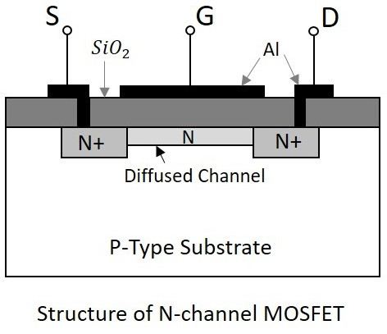
MOSFET Construction N - Channel
4

Slide 5
Cont…
A thin layer of Silicon dioxide (SiO₂) is grown over the entire surface and holes are made to draw ohmic contacts for drain and source terminals.
A conducting layer of aluminum is laid over the entire channel, upon this SiO₂ layer from source to drain which constitutes the gate. The SiO₂ substrate is connected to the common or ground terminals.
Because of its construction, the MOSFET has a very less chip area than BJT, which is 5% of the occupancy when compared to bipolar junction transistor. This device can be
operated in modes.
5

Slide 6
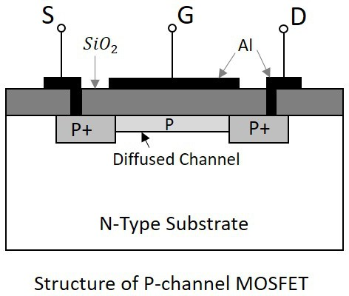
Cont… P-Channel

Slide 7
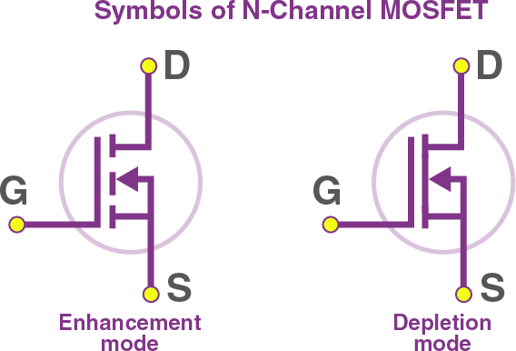
Circuit Symbols – N Channel

Slide 8

Circuit Symbols – P Channel

Slide 9
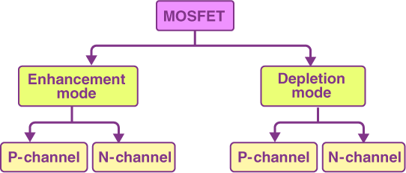
MOSFET Classification

Slide 10
Enhancement Mode
Default – No gate voltage - No channel conductivity
When there is no voltage across the gate terminal, then the device does not conduct. When there is the maximum voltage across the gate terminal, then the device shows enhanced conductivity.

Slide 11
Depletion Mode
Default: No Voltage to Gate – Maximum Conductivity
When there is no voltage across the gate terminal, the channel shows maximum conductance.
When the voltage across the gate terminal is either positive or negative, then the channel conductivity decreases.

Slide 12
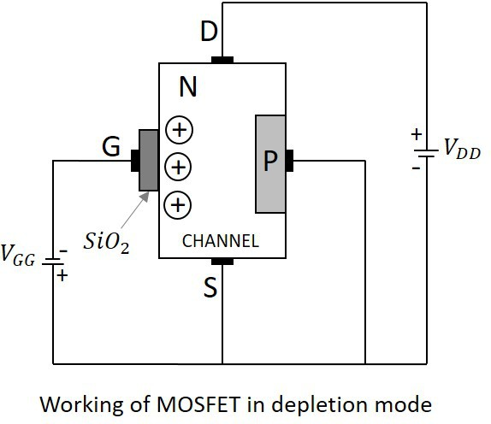
Principle of Operation – Depletion Mode

Slide 13
Cont…
No PN junction like FET, instead there is an insulation layer
Current conduction is due to the presence of diffused channel
Sio2 & Al metal contact forms, a capacitor
NMOS in Depletion Mode – Biasing Requirement – Gate to –Ve terminal & Drain is connected to the +Ve terminal of gate voltage.

Slide 14
Cont…
When no voltage is applied between gate and source, some current flows due to the voltage between drain and source.
Let some negative voltage is applied at V_{GG}.
Then the minority carriers i.e. holes, get attracted and settles near SiO₂ layer. But the majority carriers, i.e., electrons get repelled.

Slide 15
Cont…
With some amount of negative potential at V_{GG} a certain amount of drain current I_{D} flows through source to drain. When this negative potential is further increased, the electrons get depleted and the current I_{D} decreases.
Hence the more negative the applied V_{GG}, the lesser the value of drain current I_{D} will be.
The channel nearer to drain gets more depleted than at source as in FET and the current flow decreases due to this effect. Hence it is called as depletion mode MOSFET.

Slide 16
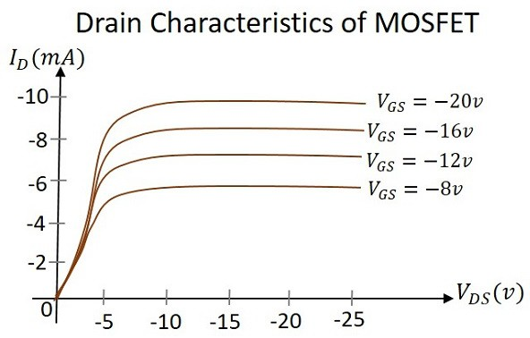
Drain Characteristics

Slide 17
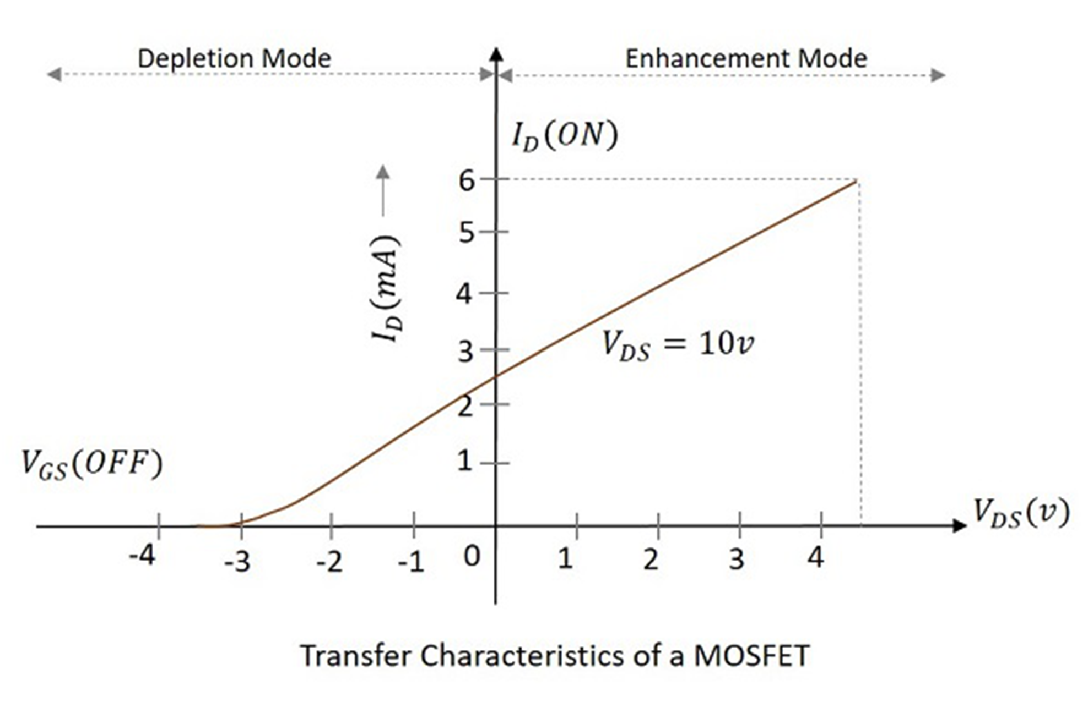
Transfer Characteristics

Slide 18
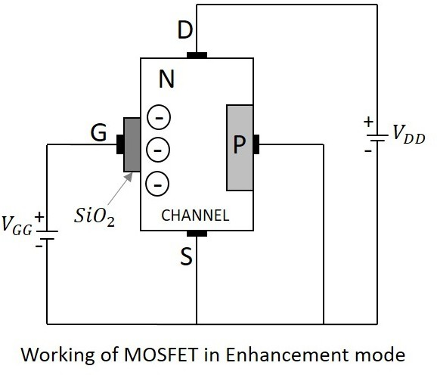
Principle of Operation – Enhancement Mode

Slide 19
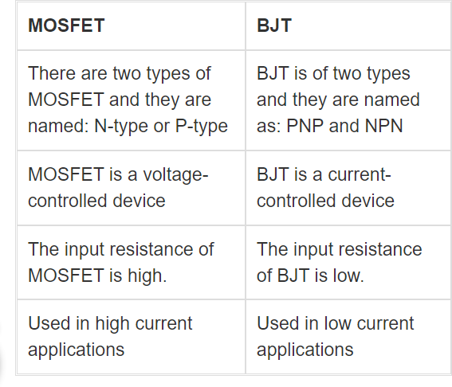
BJT Vs MOSFET

Slide 20
Advantages & Disadvantages
Advantages of MOSFET
MOSFETs operate at greater efficiency at lower voltages.
Absence of gate current results in high input impedance producing high switching speed.
Disadvantages of MOSFET
MOSFETs are vulnerable to damage by electrostatic charges due to the thin oxide layer.
Overload voltages make MOSFETs unstable.

Slide 21
Applications of MOSFET
Radio frequency applications use MOSFET amplifiers extensively.
MOSFET behaves as a passive circuit element.
Power MOSFETs can be used to regulate DC motors.
MOSFETs are used in the design of the chopper circuit.

